Slide 1


FOODY’s
Notes:
two types of people
- supermarket aimless
- same online
- I scroll endlessly
- yummly great because
- but! I want the list to change whilst I scroll
- solution: foody
- on way home, no clue what I want
- quickly converge to recipes I like

Slide 2




Solution
User Voting
Suggestion
User Preferences
Foody’s
Notes:
through clustering and calculation of similarity to preferences on that day
app will quickly help you decide what you would like
- catering for people who fancy a variety of meals

Slide 3
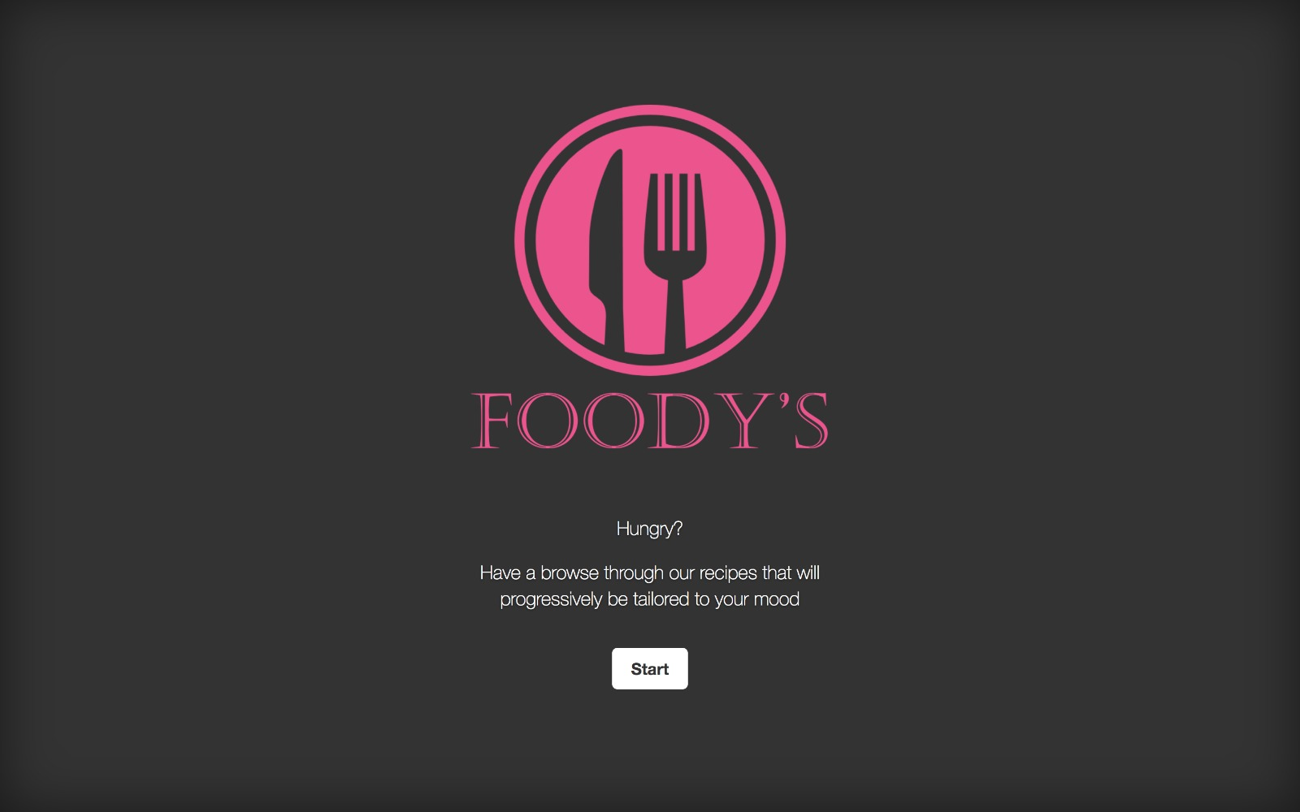
Demo
Foody’s

Slide 4



RECIPES
CLUSTERING
ALGORITHM
How it works
Foody’s

Slide 5
FOODY’s
Notes:
Forget about suggestions based on what you felt like eating weeks ago
Have a targeted browse through Foody’s and fine a meal perfect for your current mood

Slide 6

Questions?
Foody’s

